Slide 1
ReactJs Intro
Nov 2016

Slide 2
Agenda
What is React
Component
Props
State
Component life cycle

Slide 3


Slide 4
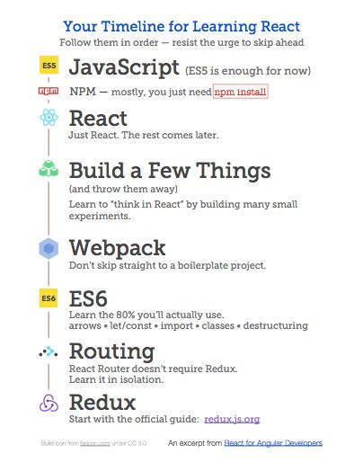
Timeline

Slide 5
What is React?
"A JavaScript Library for Building User Interfaces" -- React

Slide 6
So, It's like Angular or Ember?
No
“People use React as the V in MVC." -- React

Slide 7
So, It's a Template Library?
No
"React components are far more powerful than Angular templates; they should be compared with Angular's directives instead" --Pete Hunt (Quora)

Slide 8
Why is it Compelling?
Virtual DOM
Declarative
Modular
One-Way Data Flow

Slide 9
Virtual DOM
React abstracts away the DOM from you, giving better performance.
Re-rendering the whole app on every update is not efficient
The Virtual DOM will only update what is necessary

Slide 10
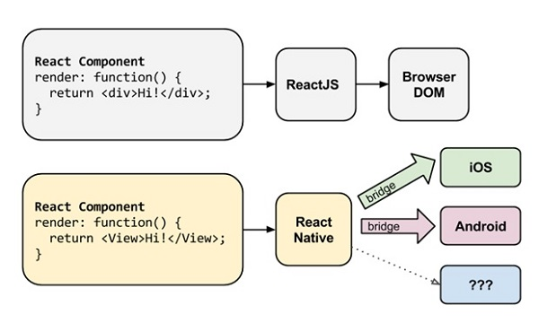
Rendering
Server side rendering - the same code runs on the client and on the server
Power native apps using React Native.

Slide 11
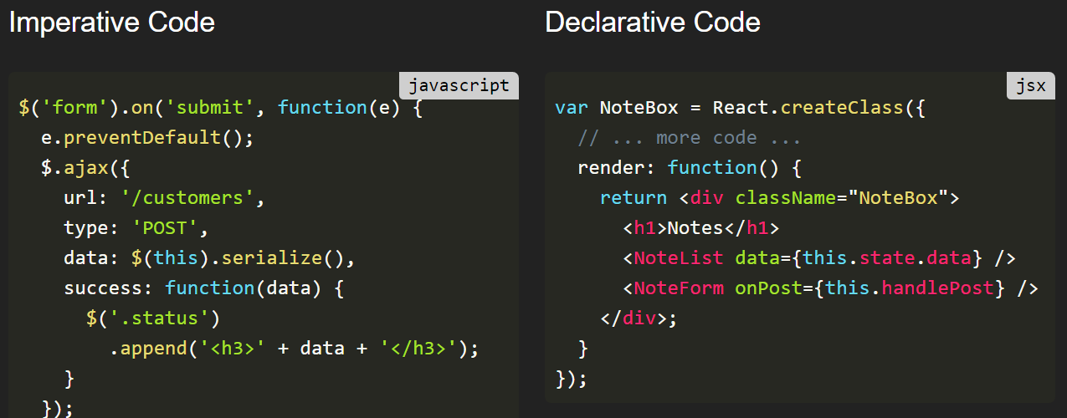
Declarative vs Imperative
Declarative as “what to do” and imperative as “how to do”.

Slide 12
One-Way Data Flow
Most important React principle
Single source of truth
Data flows from top components to bottom components
Move state up the tree!
Keep components stupid!

Slide 13
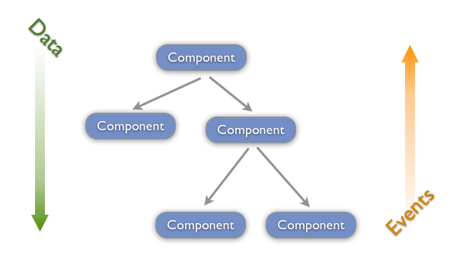
One-Way Data Flow

Slide 14
One-Way Data Flow is Fast
No watching or dirty-checking objects
DOM updates are slow, not JS itself
React does minimal DOM updates possible
React batches reads and writes, it's hard to do this manually
Can do this all at 60fps on React Native

Slide 15
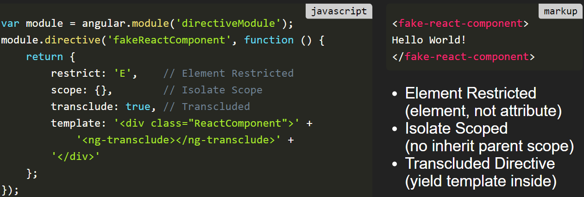
Angular Directive vs React Component

Slide 16
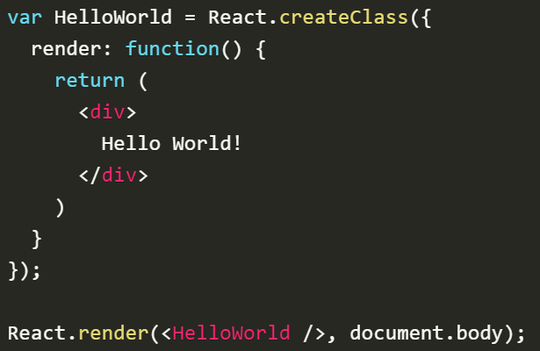
Hello World Component

Slide 17

JSX
Normally you embed the JavaScript into the HTML, that is the way most JavaScript libraries work.
ANGULAR, EMBER AND KNOCKOUT PUT “JS” IN YOUR HTML.
REACT PUTS “HTML” IN YOUR JS

Slide 18
Component
They need to be named.
They have only one root node.
There are different types of Components and they can be created in different ways.
They must be rendered into a target element in the DOM.
They can contain other components (Composition).
They can accept input data through (prop / properties).
They can store their own data (states) and they REACT when this data changes.
They respond to events.

Slide 19
Prop vs State
props (short for properties) are a Component's configuration, its options if you may. They are received from above and immutable as far as the Component receiving them is concerned.
The state starts with a default value when a Component mounts and then suffers from mutations in time (mostly generated from user events).
Simply ask three questions about each piece of data:
Is it passed in from a parent via props? If so, it probably isn't state.
Does it remain unchanged over time? If so, it probably isn't state.
Can you compute it based on any other state or props in your component? If so, it isn't state.

Slide 20
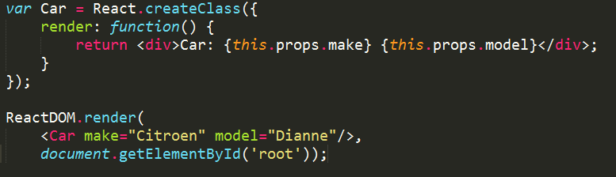
Props
Result:
Car: Citroen Dianne

Slide 21
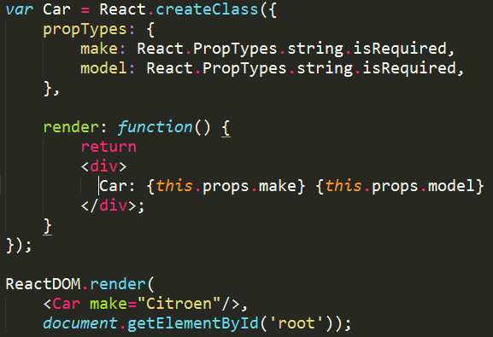
PropsTypes
Notes:
array, bool, func, number, object, string, node, element, any, instanceOf(Message), oneOf(['News', 'Photos']), oneOfType([]), arrayOf(number), objectOf(number), shape({}), customProp: function(props, name, _) {}

Slide 22
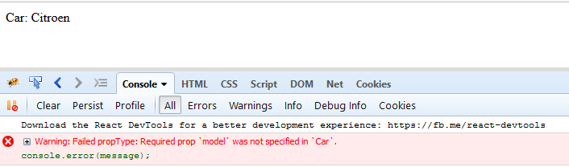
PropsTypes
So what happens if you do not conform to the defined propTypes?
React will log a warning to the console at runtime.
React will only do this when you are in a development environment (defined by the global NODE_ENV variable) to save performance in production.

Slide 23
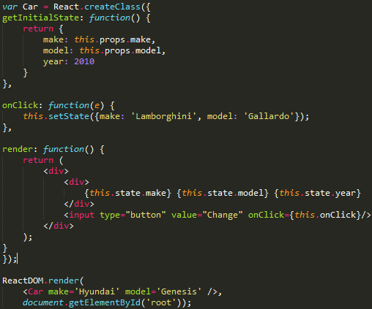


State

Slide 24
State
However, you cannot just do this:
this.state.make = 'Lamborghini';
You have to call setState instead. this.setState({make: 'Lamborghini', model: 'Gallardo'});
This function is used to update the state of a Component. It will cause a Component to be re-rendered.

Slide 25
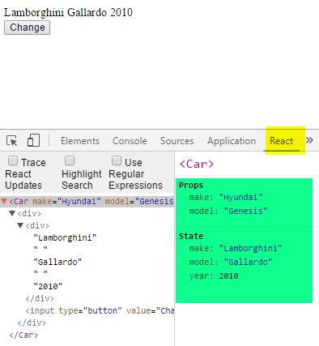
Tools
React Developer Tools
Notes:
https://chrome.google.com/webstore/detail/react-developer-tools/fmkadmapgofadopljbjfkapdkoienihi

Slide 26
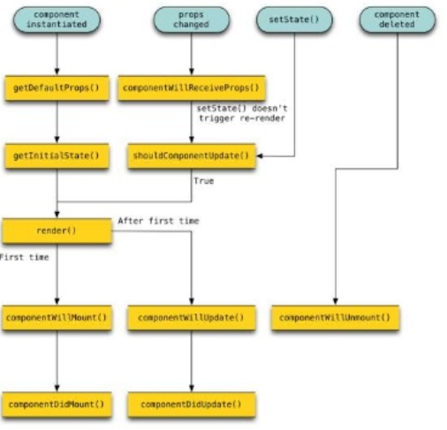
Component Lifecycle

Slide 27
Component Lifecycle
Mounting: A component is being inserted into the DOM.
Updating: A component is being re-rendered to determine if the DOM should be updated.
Unmounting: A component is being removed from the DOM.

Slide 28
Component Mounting
componentWillMount
Fired once, before initial rendering occurs.
Good place to wire-up message listeners.
this.setState doesn't work here.
componentDidMount
Fired once, after initial rendering occurs.

Slide 29
Component Updating
componentWillReceiveProps
Fired when a component is receiving new props.
You might want to this.setState depending on the props.
shouldComponentUpdate
Fired before rendering when new props or state are received.
return false if you know an update isn't needed.

Slide 30
Component Unmounting
componentWillUnmount
Fired immediately before a component is unmounted from the DOM.
Good place to remove message listeners or general clean up.

Slide 31
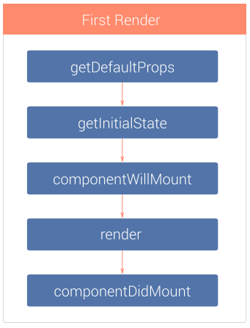
Initial Render

Slide 32
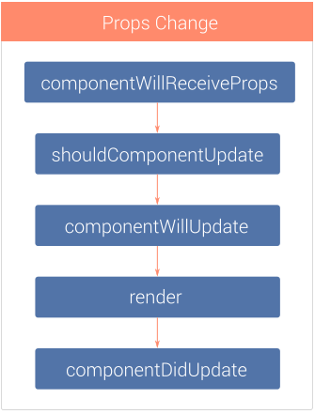
Props Change

Slide 33
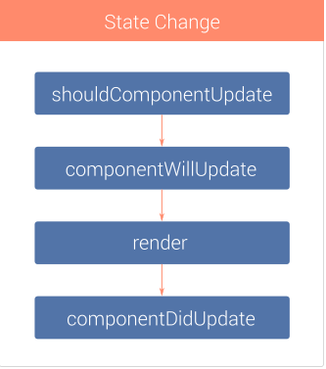
State Change

Slide 34
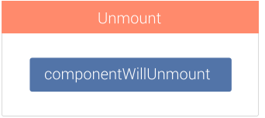
Unmount

Slide 35
Looking forward…
Event handler
CSS
AJAX
Routing
Forms
Testing

Slide 36

Special Thanks
http://elijahmanor.com/talks/react-to-the-future/
http://slides.com/danabramov/components-react-flux-wip
https://staminaloops.github.io/undefinedisnotafunction/understanding-react/
Mark Clow, Learn React Fast

